Slide 1

Leveraging Social Determinants of Health (SDOH) Analytics to Address Healthcare Disparities
Presentation by Emmanuel Daramola

Slide 2

DATA FRAGMENTATION
Accessing a thorough understanding of health disparities is challenging due to the fragmented nature of important datasets such socioeconomic determinants, health records, and demographic data.
ABSENCE OF REAL-TIME INSIGHTS
In the absence of automated systems, responses and resource allocation are delayed due to a lag in discovering new health problems or inequities.
BUSINESS SCOPE & CHALLENGES
MANUAL DATA PROCESSING
The business still uses manual data processing to get insights, which causes delays in decision-making and raises the possibility of mistakes.
GEOGRAPHICAL DATA GAPS
Targeted interventions are hampered by the lack of precise geographical data, which makes it difficult to visualise and analyse regional healthcare disparities.

Slide 3
INTEGRATE SDOH DATA
To guarantee thorough insights into health inequalities, combine different clinical, demographic, and geographic data into a single, cohesive system.
AUTOMATE DATA PROCESSING
By streamlining data processing and lowering the need for manual labour, automated processes can improve accuracy and efficiency.
PROJECT OBJECTIVES
&
DELIVERABLES
CREATE REAL-TIME DASHBOARDS
To enable real-time monitoring of health disparities and speed up decision-making and actions, create interactive dashboards.
ENABLE PROACTIVE INTERVENTIONS
By providing real-time insights, healthcare organisations and providers can take early action to address new health issues before they become more serious.

Slide 4
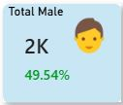
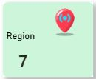
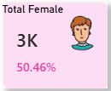
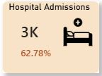
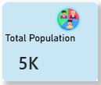
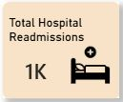
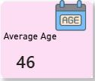
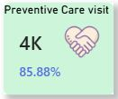
KPIs

Slide 5
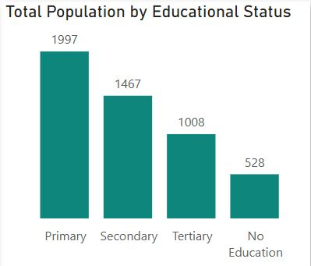
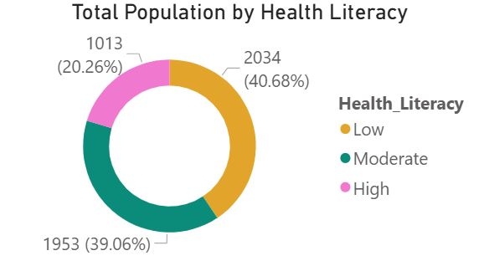
Highest population (1,997) had only primary school education which contributes to many population having Low health literacy level(40.68%)

Slide 6
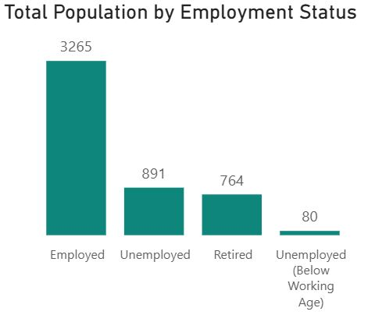
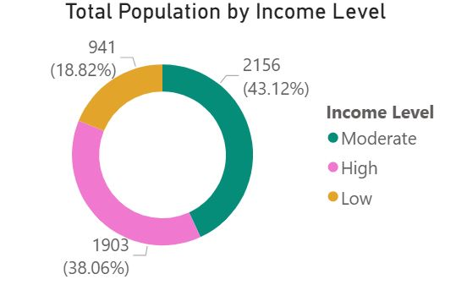
Highest population (3,265) are employed while the income level status of the population is on the moderate level (43.12%)

Slide 7
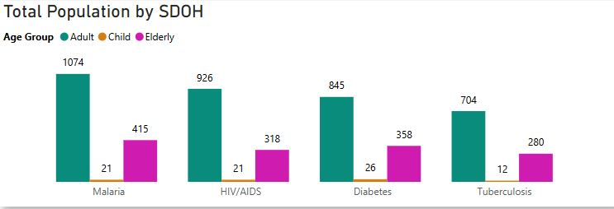
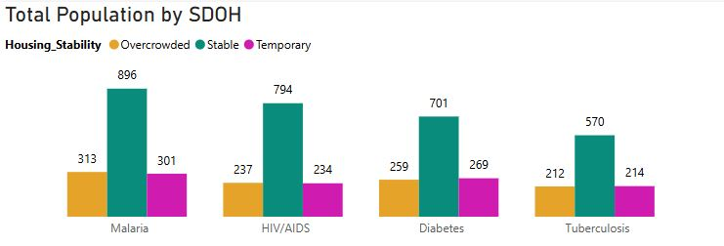
The Child age group is found to experience less chronic diseases compared to other age group ( Adult and elderly).
The population with a stable housing status experience more chronic diseases

Slide 8
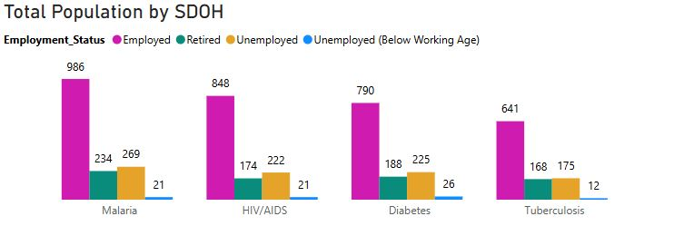
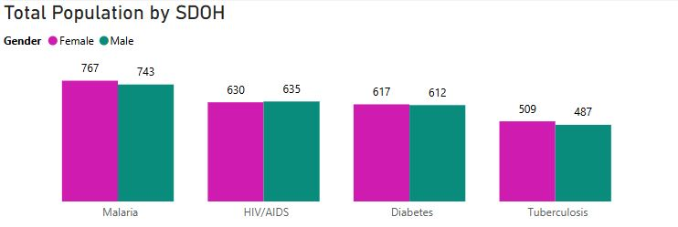
The Unemployed(Below working Age) population is found to experience less chronic diseases compared to other employment status ( Employed, Retired, Unemployed).
More Female experience chronic diseases than the Male

Slide 9
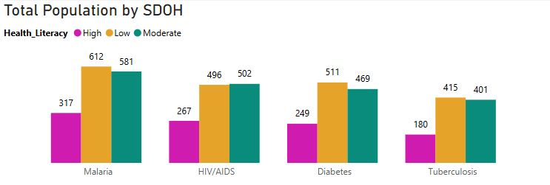
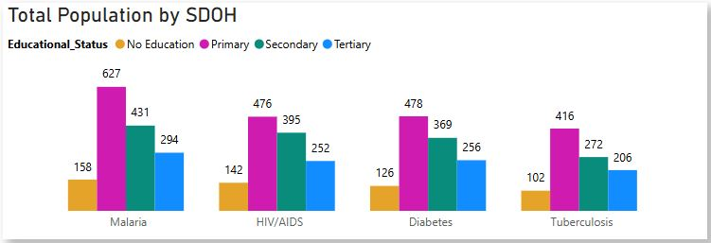
The population with Low and moderate health literacy experience more chronic diseases.
The population with primary and secondary educational status experience more chronic diseases compared to other status( Tertiary)

Slide 10
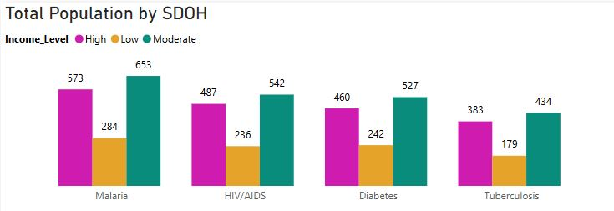
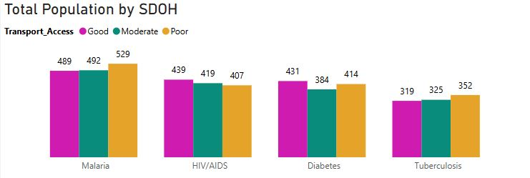
The population with low-income level experience less chronic diseases.
The population with poor transport access experience more chronic disease.

Slide 11
KEY OBSERVATIONS 1
The largest population segment has only primary education, contributing to low health literacy (40.68%).
Populations with low and moderate health literacy experience higher rates of chronic diseases.
Individuals with primary and secondary education show worse health outcomes than those with tertiary education.

Slide 12
RECOMMENDATION
Integrate education level and health literacy indicators into the unified SDOH data model and use them as key risk stratification variables. This will allow healthcare organisations to:
Identify high-risk populations early
Deploy targeted health education programs (e.g., simplified care plans, community outreach, preventive screenings)
Prioritise Health Literacy & Education-Driven Interventions

Slide 13
KEY OBSERVATIONS 2
While a large portion of the population is employed, income levels remain largely moderate (43.12%).
Adults and elderly populations experience more chronic diseases than children.
Stable housing does not necessarily correlate with lower chronic disease prevalence, suggesting economic strain beyond housing stability.

Slide 14
RECOMMENDATION
Automate the ingestion and processing of employment status, income level, and age demographics into predictive dashboards. These dashboards should flag:
Employed but financially vulnerable populations.
Adult and elderly cohorts with rising chronic disease prevalence
This enables healthcare providers to allocate resources such as preventive care programs and chronic disease management support more effectively.
Use Employment & Income Data to Predict Chronic Disease Risk

Slide 15
KEY OBSERVATIONS 3
Females experience higher rates of chronic diseases than males.
Children show significantly lower chronic disease prevalence, while adults and elderly populations are at higher risk.
Employment status impacts outcomes, with unemployed (below working age) populations experiencing fewer chronic diseases.

Slide 16
RECOMMENDATION
Develop real-time dashboards segmented by gender, age group, and employment status to support:
Gender-specific health programs
Age-appropriate preventive interventions
Early detection of rising risks in adult and elderly populations
Implement Gender-Sensitive and Age-Specific Health Monitoring

Slide 17
KEY OBSERVATIONS 4
Manual data processing contributes to delays in identifying emerging health disparities.
Multiple SDOH factors (education, literacy, income, gender, age) intersect to influence chronic disease prevalence.

Slide 18
RECOMMENDATION
Implement automated workflows that continuously update SDOH indicators and trigger alerts when thresholds are breached (e.g., rising chronic disease rates among low-literacy or moderate-income populations).
This reduces reliance on static reports and ensures decision-makers have real-time, actionable insights.
Strengthen Automated SDOH Monitoring to Reduce Decision Lag

Slide 19
CONCLUSION
The analysis of Social Determinants of Health highlights clear disparities driven by education level, health literacy, income status, age, and gender, all of which significantly influence chronic disease prevalence. Populations with lower educational attainment and limited health literacy are disproportionately affected, while adults, elderly individuals, and females show higher vulnerability to chronic conditions.
By integrating SDOH data into a unified system, automating data processing, and leveraging real-time dashboards, the organisation can move from delayed, reactive decision-making to timely, proactive interventions. These data-driven recommendations enable targeted resource allocation, early risk identification, and improved health outcomes, ultimately supporting a more equitable and efficient healthcare system.

Slide 20
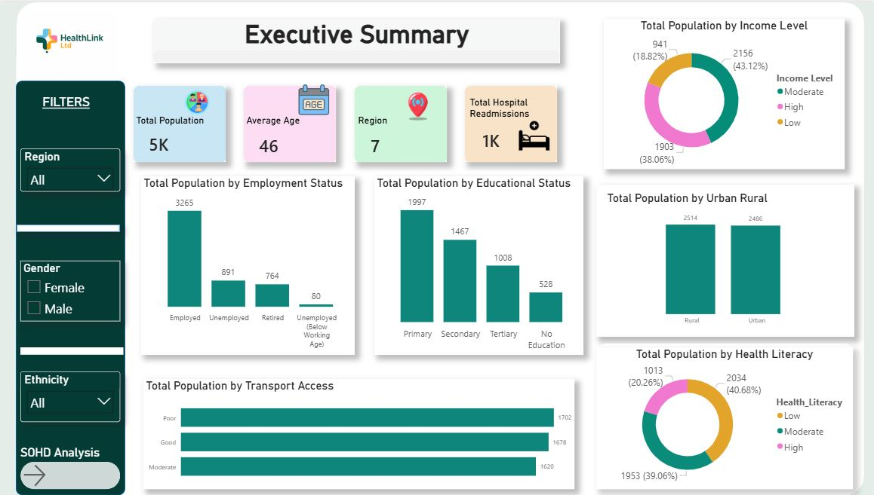

Slide 21
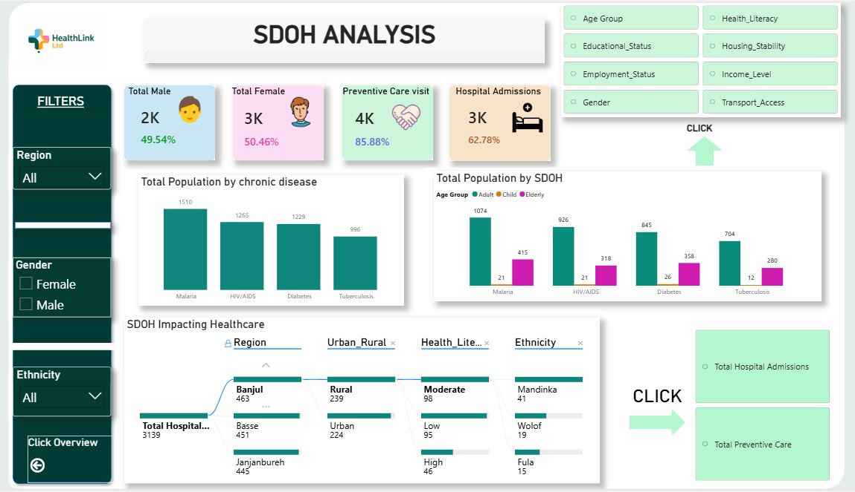

Slide 22
THANK YOU

